Slide 1
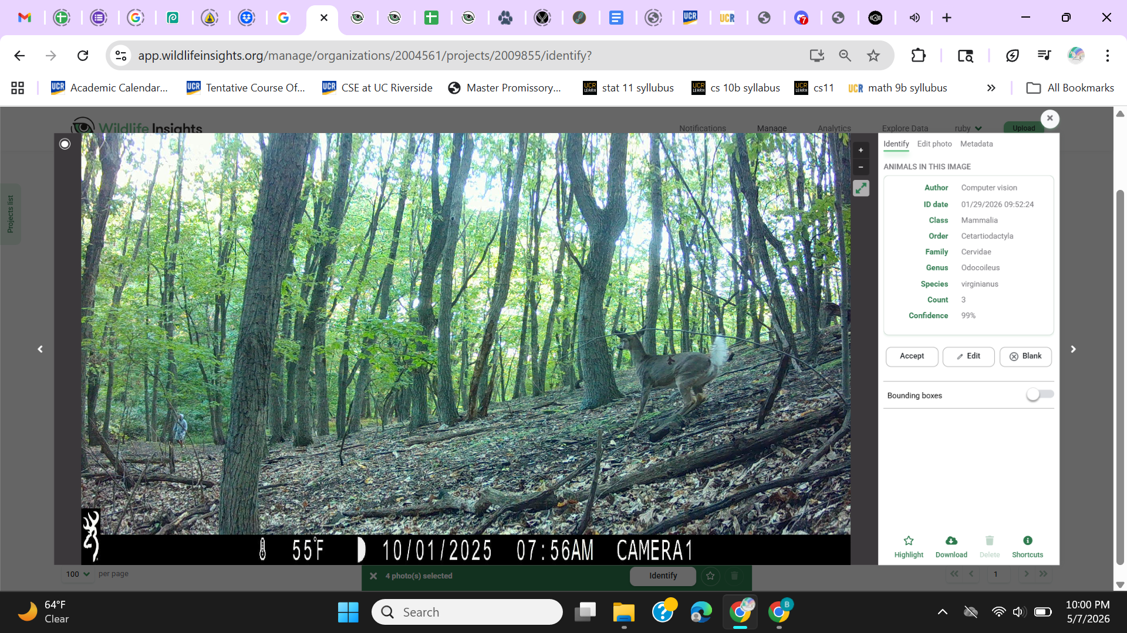
An Analysis of Interactions Between Collared and Non-Collared White-Tailed Deer in Staten Island
By: Ruby (Huihua) Situ

Slide 2
Data

Slide 3
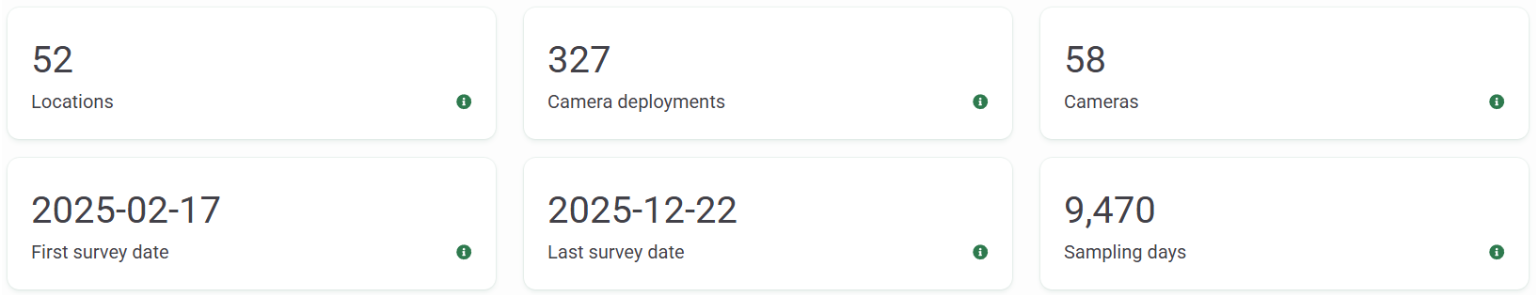
Wildlife Insights
All images identified and annotated manually (shout out Marc and Nat)
159,034 rows originally
65,320 deer images after removing the BLK images
A deer is blocking most of the camera view
32,386 usable images after removing “bursts”
Multiple images snapped in a burst, all within 1 second

Slide 4
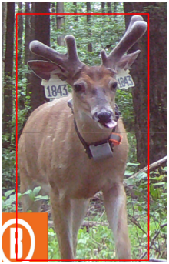
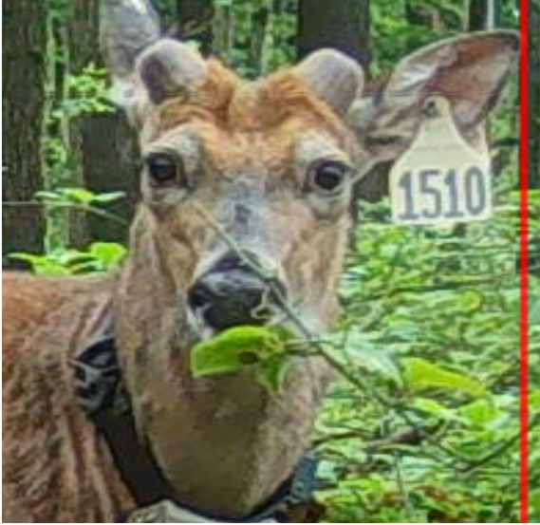
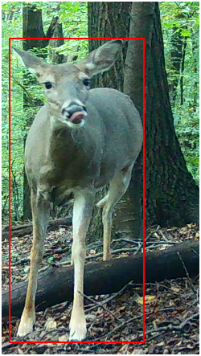
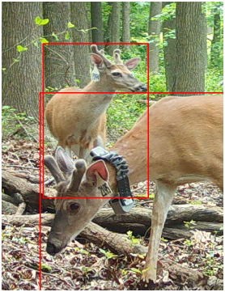
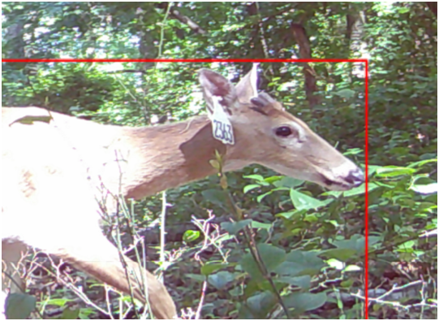
No tag, no collar
Example of images
Tagged & Collared
C_T + NC_T
interaction
Tagged, no collar

Slide 5
Methodology

Slide 6
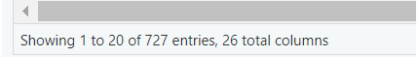
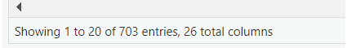

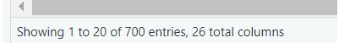
Time intervals
1 minute
Using time intervals to count interactions
Reduce chance of over estimation
A new interaction is counted as when the deers in the image changes or time exceeds a certain time
Decided on 3 minutes as a happy medium
3 minutes
4 minutes
5 minutes

Slide 7


Time vs Markings
Fairly stable number of interactions
Slightly more interactions due to changing deer
Not a big issue overall
Continuing with a combined method of counting new interactions as a result of
exceeding time OR changing deer
New interaction as a result of exceeding time
New interaction as a result of changing deer

Slide 8
Separating types of interactions
6 types of interactions involving collared deer, + indicates interaction
Can be more than one deer in category, but each type of interaction is exclusive.
Collared + Non-Collared but Tagged (Exclusively 1 collared deer)
Collared + Collared <- EX: Can have more than 2 deer, but everyone in frame is collared
Collared + Non-Collared and Not Tagged (Exclusively 1 collared deer)
Collared + Collared + Non-Collared and Not Tagged
Collared + Collared + Non-Collared and Tagged
Collared + Collared + Non-Collared and Not Tagged + Non-Collared and Tagged
Collared = C, No Collar = NC, Tagged = T, No Tag = NT
Allows a deeper look into who is interacting with who
Mapped out later

Slide 9
Modeling
Zero Inflated Negative binomial doesn’t apply
It is meant to be used when “excess zeros are generated by a separate process from the count values and that the excess zeros can be modeled independently”
This data’s zeros/1’s were generated from the same process and doesn’t make sense to model them independently
Negative binomial, Gamma, and binomial were the top choices
Gamma fits better as duration is not exactly count data even though it is whole numbers

Slide 10
EDA

Slide 11
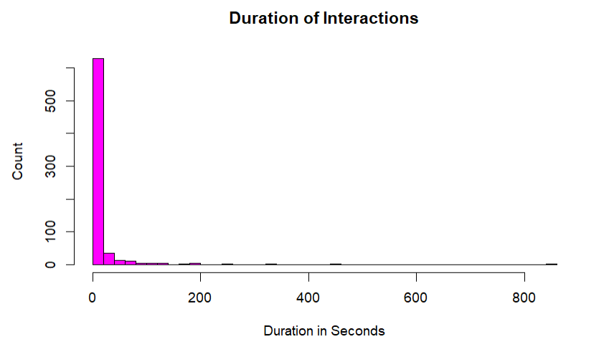
Extreme right skew
Most interactions were a single photo making the duration just 1 second

Slide 12
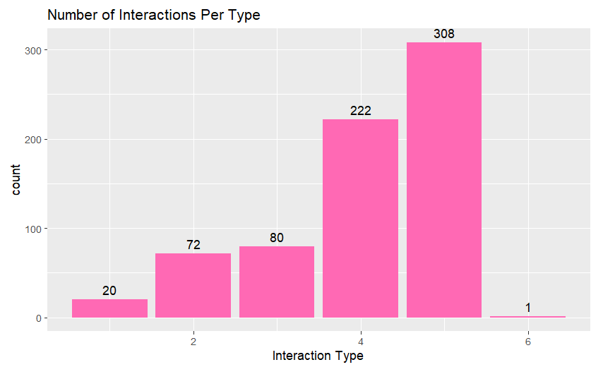
1 = C+C+(NC_T)
2 = C + C + (NC_NT)
3 = C + C
4 = C + (NC_T)
5 = C + (NC_NT)
6 = C + C + (NC_T)+(NC_NT)
Legend
* Most deer have no tag and no collar, inflating type 5

Slide 13
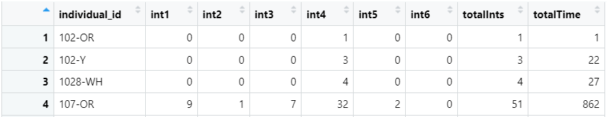
Interactions for individual tagged deer
64 unique IDs found in interactions
1713-WH had the highest duration of interaction at 1541 seconds from 14 interactions
2135-WH was a close second at 1525 seconds from 10 interactions
119-OR had the highest amount of interactions at 53 separate interactions spanning 410 seconds
107-OR was a close second at 51 interactions spanning 862 seconds
This also places 107-OR at 3rd place for duration of interaction
119-OR (collared) had the highest number of interactions with NC_NT deer with 27 (type 5)
109-OR (collared) was second with 20 interactions with NC_NT deer (type 5)
107-OR (collared) interacted the most with NC_T deer at 32 (type 4)
113-Y (NC_T) was a close second at 30 interactions with collared deer (type 4)

Slide 14
Analysis

Slide 15
Does the proportion of female deer increase the interaction time between collared and non-collared individuals or do seasons have a greater effect?

Slide 16
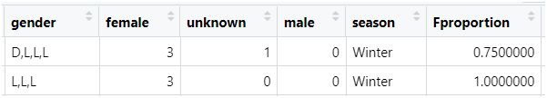

Data prep
Removed type 3 interactions (C+C)
Only interested in C+NC interactions
Extracted the gender from the markings
Count # of females per row
# Female / Total # of Deer = Proportion of female deer
Created a seasons column based on the months, not the subproject name

Slide 17
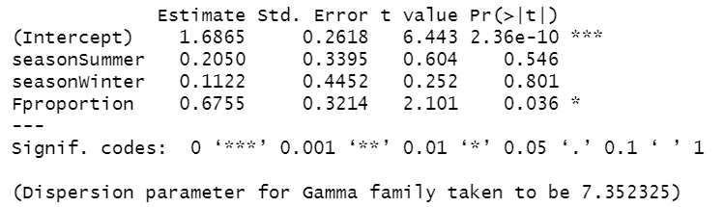
Gamma with Full Dataset
Very high overdispersion, variance much higher than mean
Non-normal data
AIC 3831.3 with negative binomial VS AIC 3738 with Gamma
Gamma is a better choice than Negative Binomial
However, the results and graphs were actually almost the same for both models

Slide 18
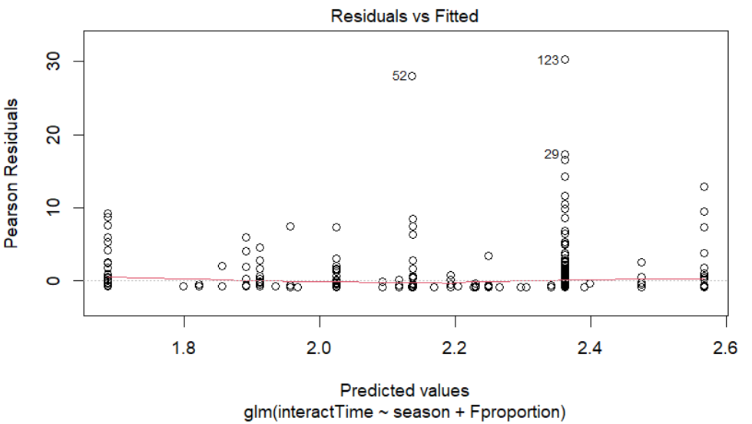
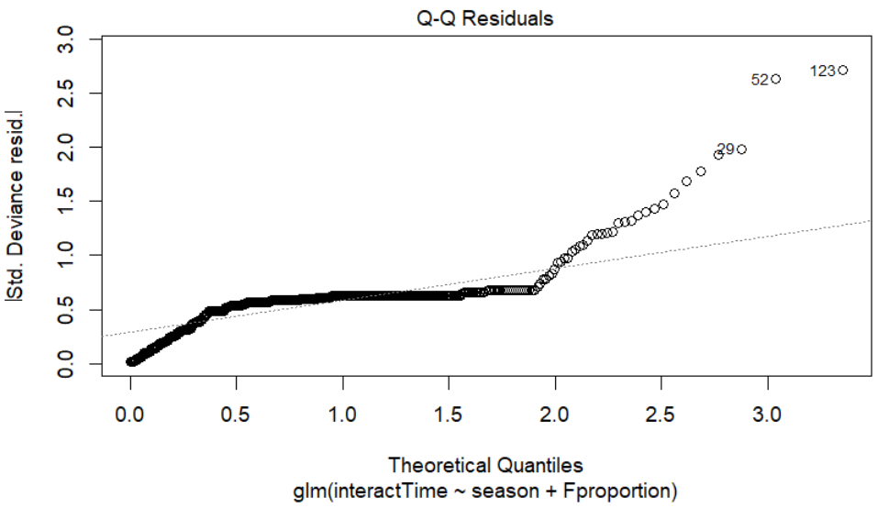
Gamma with Full Dataset
Data is not normally distributed
Horizontal line so we can assume equal variance, stacking points likely due to seasons being categorical

Slide 19

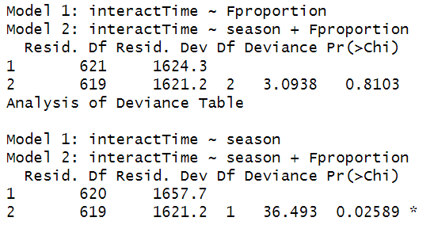
Gamma with Full Dataset
Proportion of female deer has a significant positive impact on the duration of the interaction
Seasons do not have a significant effect
ANOVA test and log likelihood tests
Fprop+season
Fprop
Season
We can tell seasons has little effect by the log likelihood becoming more negative
The anova comparison table also showed that adding seasons into the model had no significant effect based on the large p-value.
Adding Fproportion had a significant positive effect on the model fit.

Slide 20
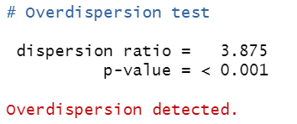
Further Questions
Over dispersion remains high when I tested both negative binomial and gamma distribution
Not necessarily a problem to have super high overdispersion since gamma works with it well but it is nice to look deeper into it
Caused by the extreme proportion of interactions that were captured for 1 second or less
The data is non-normal, the overdispersion is expected

Slide 21
Does the proportion of female deer influence the chance of an interaction between collared and non-collared individuals lasting longer than 1 second?

Slide 22
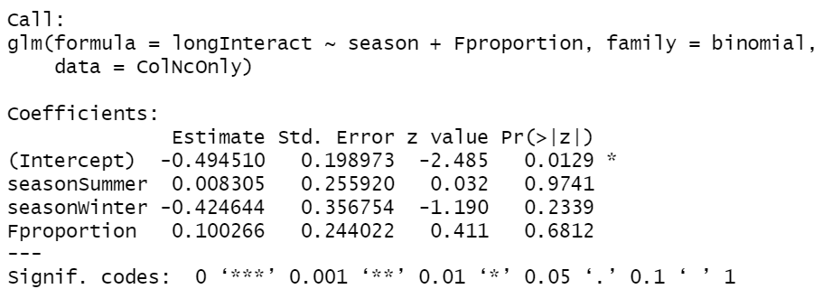
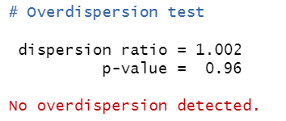
Proportion of female deer and differing seasons both had no significant influence on the chance of a duration lasting longer than 1 second
Binomial also prevented overdispersion

Slide 23
Does the proportion of female deer increase the length of interactions between collared and non-collared individuals in cases that are over 1 second?

Slide 24
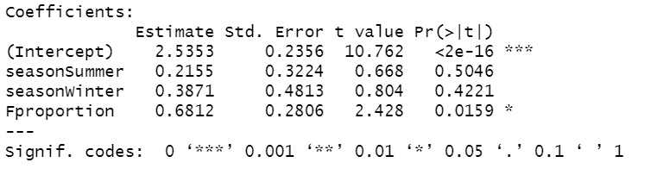
The proportion of female deer has a significant positive impact on the length of interaction when the interaction is already over 1 second
p-value of 0.0159
Seasons have no significant effect
Overdispersion is still there, but it is lower than when the 1 second interactions were included, and the data is not normal to begin with so it can be acceptable

Slide 25
Maps

Slide 26
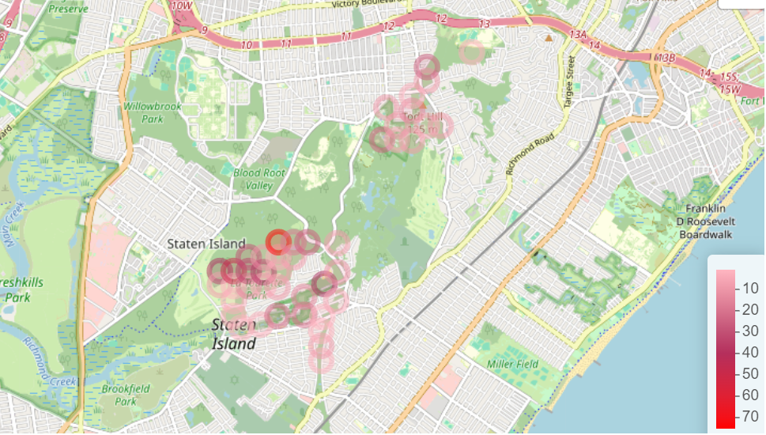
Distribution of Collared + No Collar interactions

Slide 27
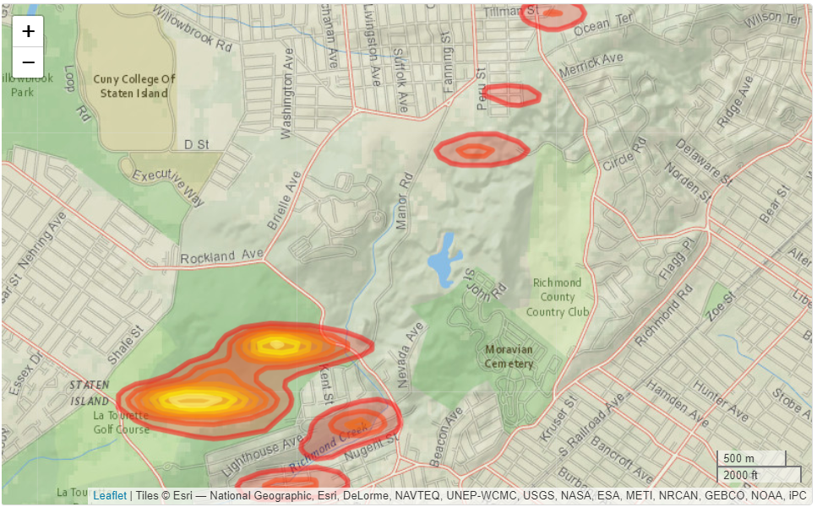
Kernel Density Estimation Map of the Collared + No Collar interactions

Slide 28
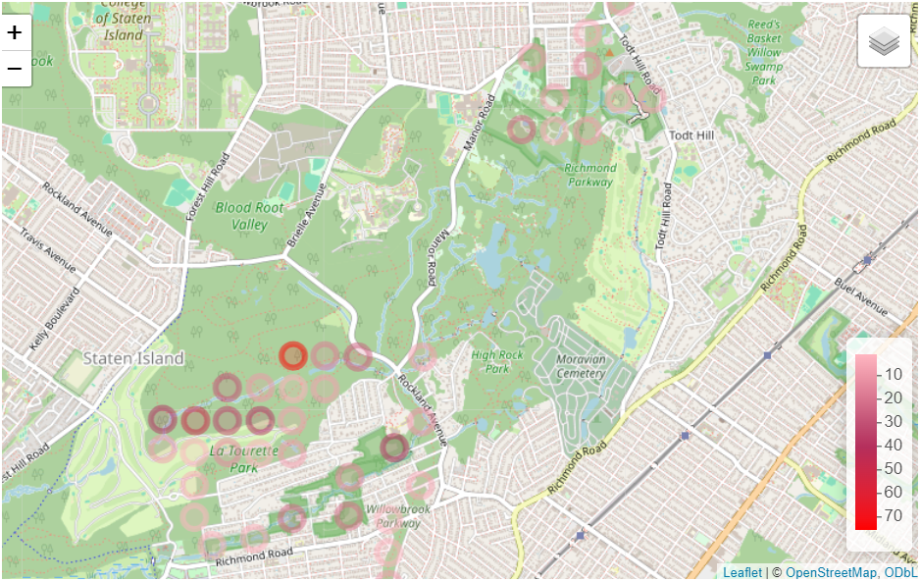
Overlay

Slide 29
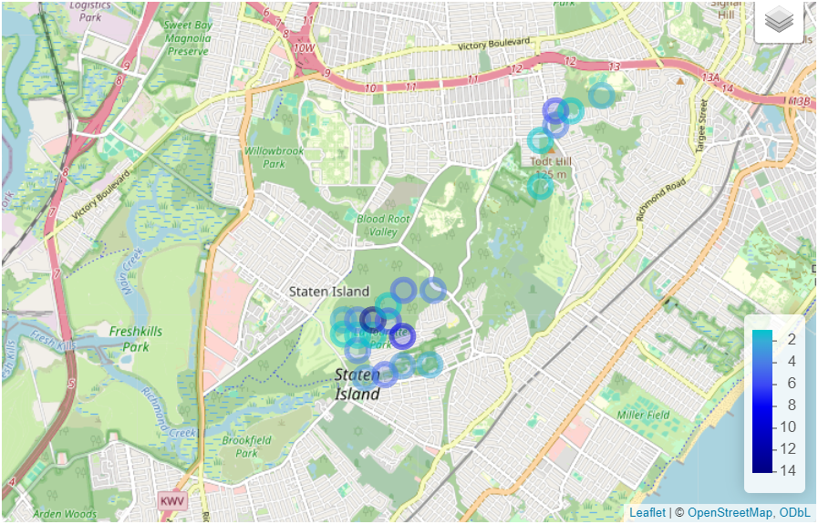
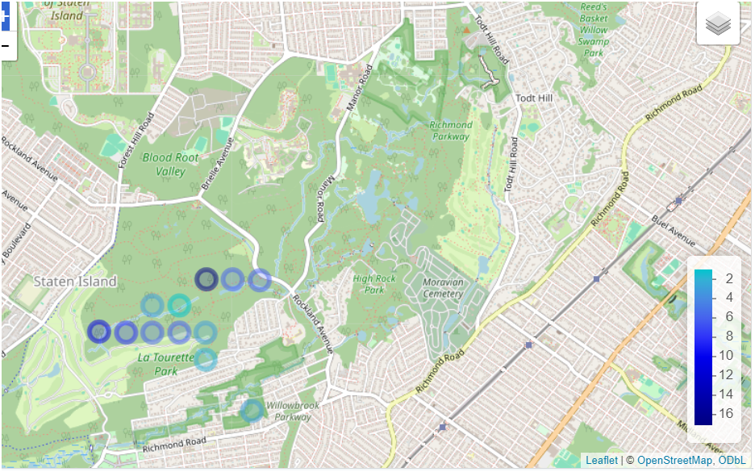
At Least 2 collared + at least 1 no collar, no tag deer
C + C + NC_NT
↓
At least 2 collared deer interacting without any non-collared deer
C + C
↓

Slide 30
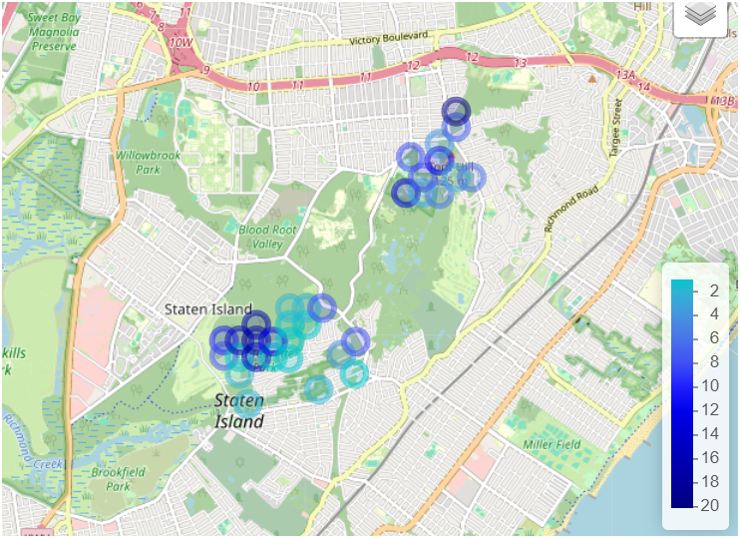
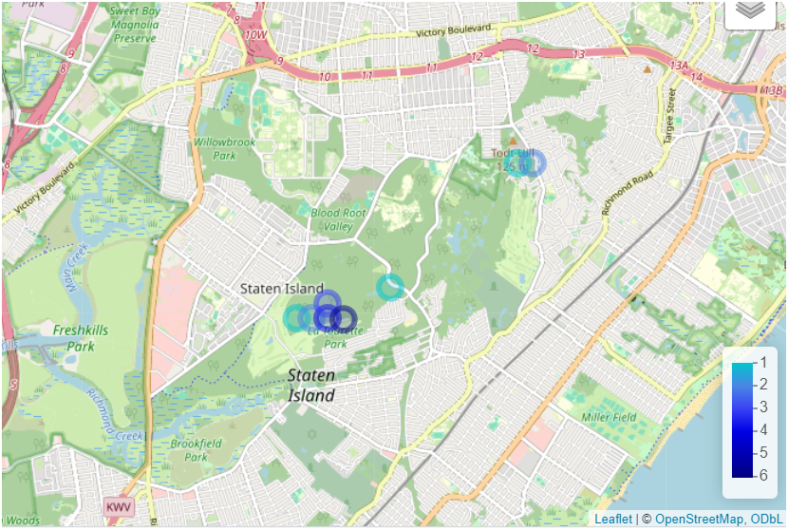
At Least 2 collared + at least 1 no collar, tagged deer
C + C + NC_T
↓
1 collared deer interacting with atleast 1 non-collared deer
C + NC_T
↓

Slide 31
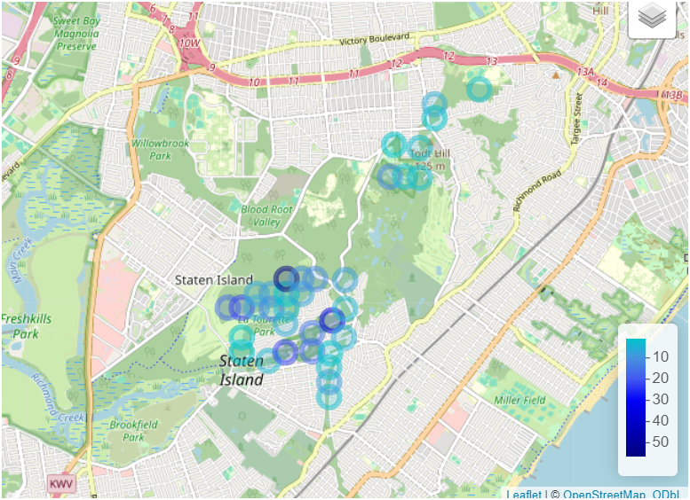
1 collared deer interacting with at least 1 uncollared, untagged deer
C + NC_NT

Slide 32
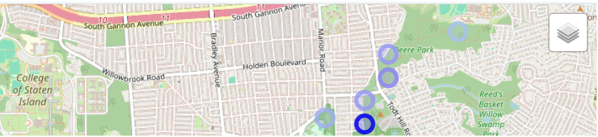
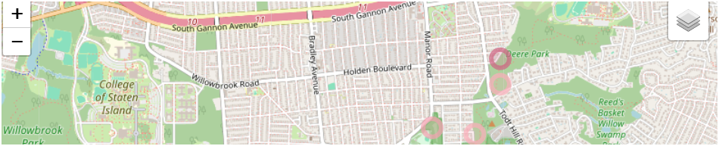
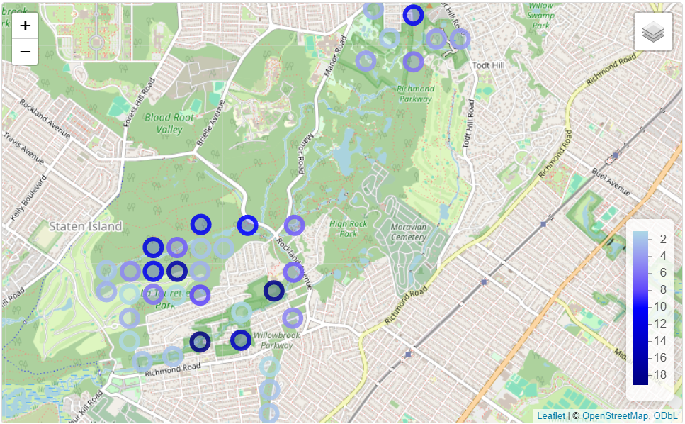
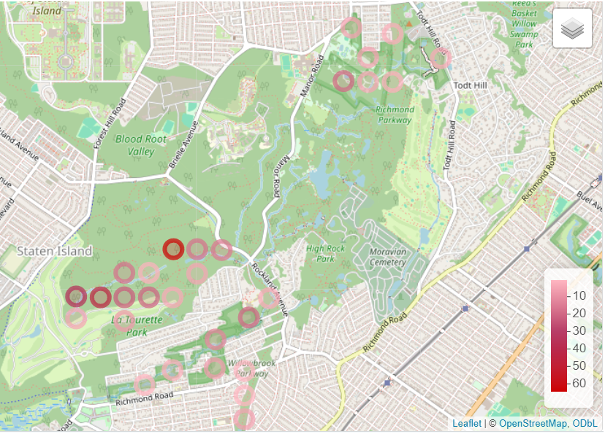
Day Vs Night C + NC interaction frequency
Extras points here at night
None during the day
Relatively darker points in residential areas at night

Slide 33
Findings

Slide 34
Heat map showed similar results to the frequency map but image was much less clear
I did not put it in the slides as it did not give any new information
C + NC interactions were much less frequent at night
Interactions move more towards Richmond Creek at night
Interactions appear more frequent towards water sources and residential areas at night
Looking at the darker dots on each map
KDE map and the frequency map are similar, but not exactly in the same spots
The KDE estimates where the distribution of interactions likely is, showing the hotspots in yellow
Centered around the golf course

Slide 35
The proportion of female deer in an interaction has a significant positive effect on the interaction duration
It also has a significant positive effect on length of interaction in cases where the interaction already exceeds 1 second
It has no significant effect on the probability of an interaction exceeding 1 second
Seasons have no significant effect on interaction duration or probability of an interaction exceeding 1 second
81.86% of interactions were from March → May, aka Spring
Using months to determine season, not the subproject name
Made doing seasonal analysis not very feasible

Slide 36
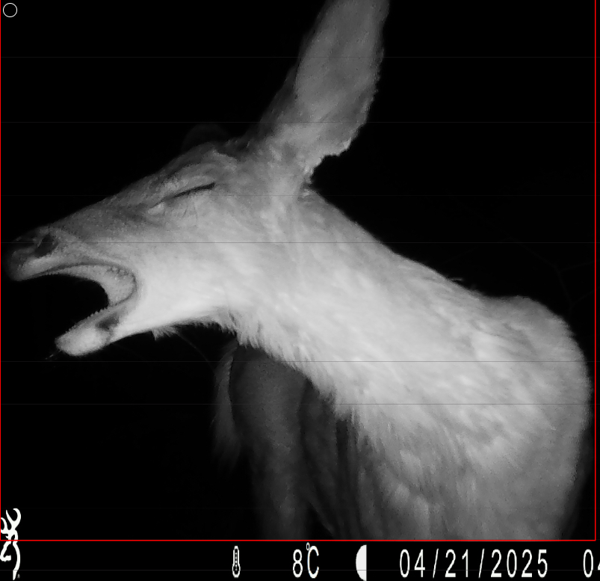
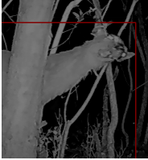
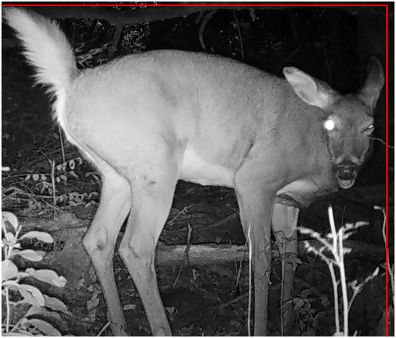
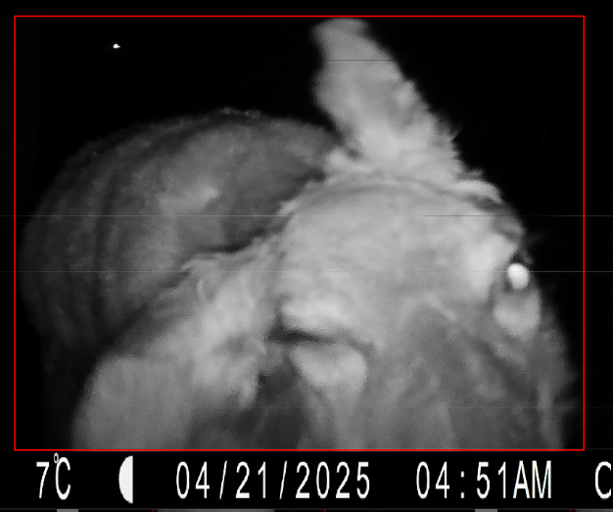
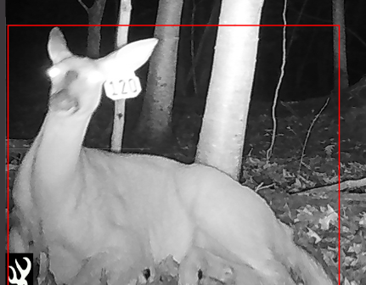
Thank you!

